Slide 1
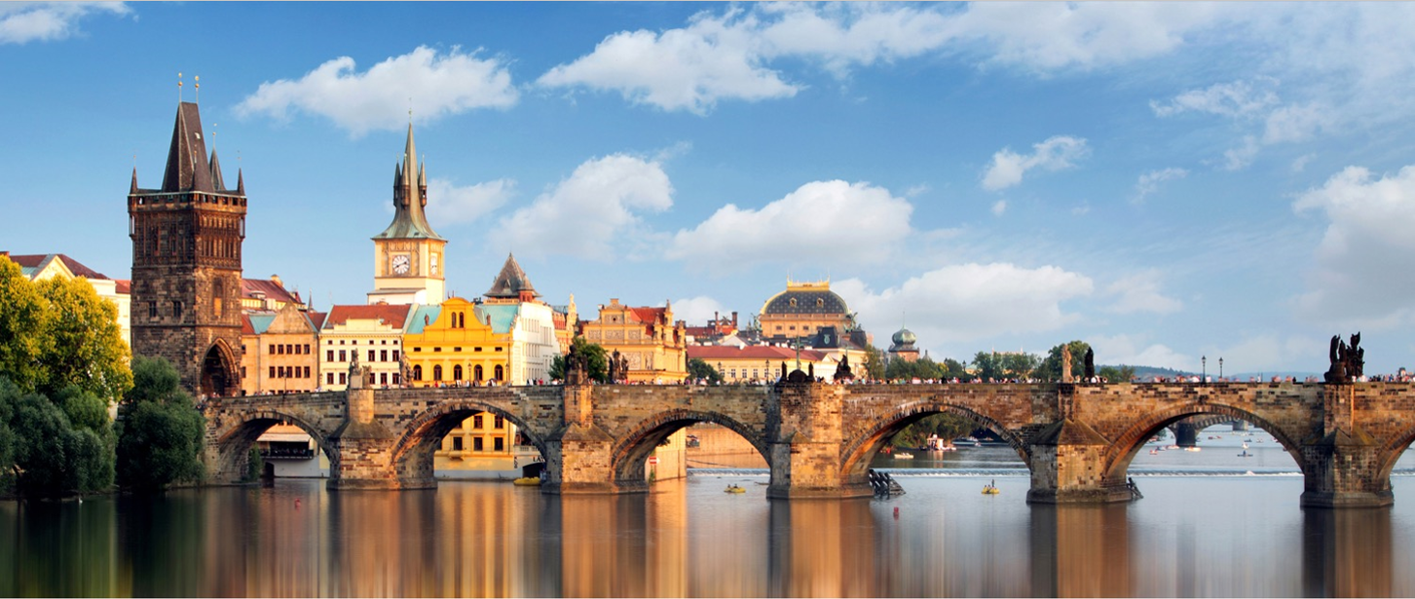
Berlin, Prague, Krakow and Budapest
10 days
Group Leader: Kyla Greve

Slide 2




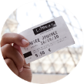

Our meeting will cover
Why travel is important
Our tour
Our educational partner
The safety
approach
What’s included
and what’s not
How to reserve
your spot

Slide 3
Why travel is important

Slide 4
Why travel?
  My travel story
  Helps develop a global perspective
  Prepares students to stand out on post-secondary applications and in future careers
  Sparks a sense of confidence

Slide 5
Our Tour

Slide 6

Notes:
Berlin
https://www.youtube.com/watch?v=ktfH8AQiUlQ

Slide 7
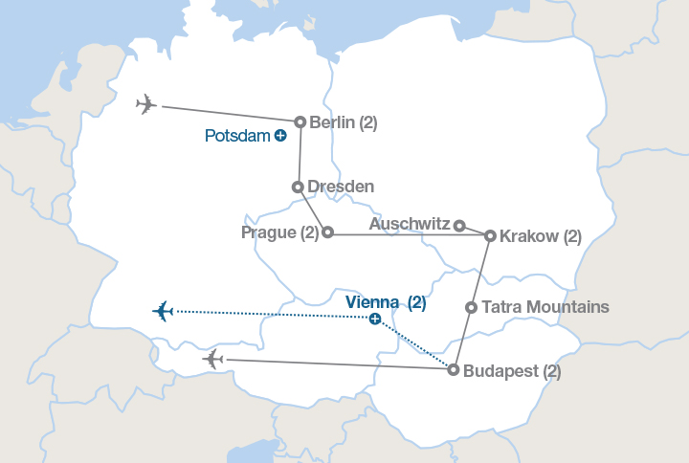
Our tour

Slide 8
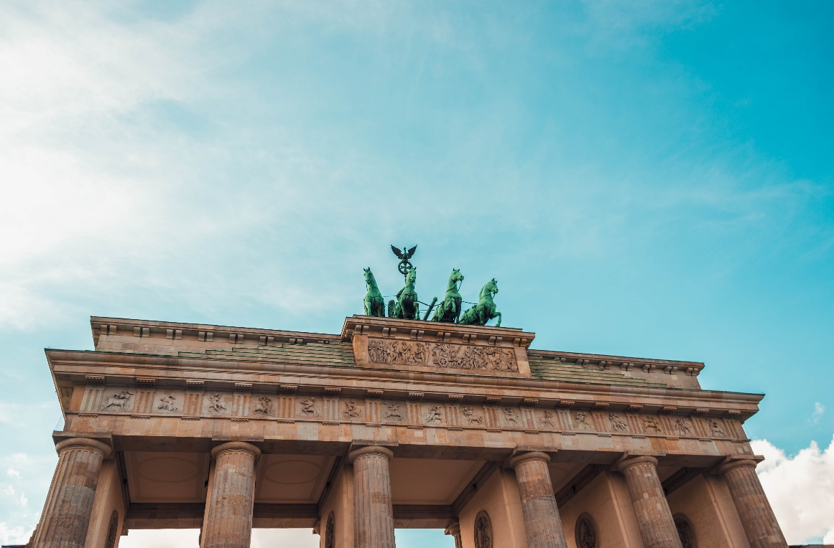
Tour highlights

Slide 9
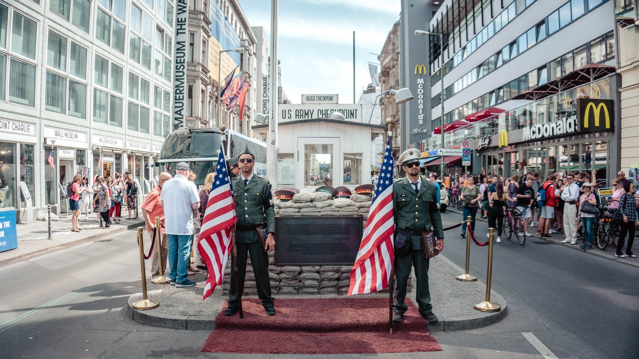
Tour highlights

Slide 10
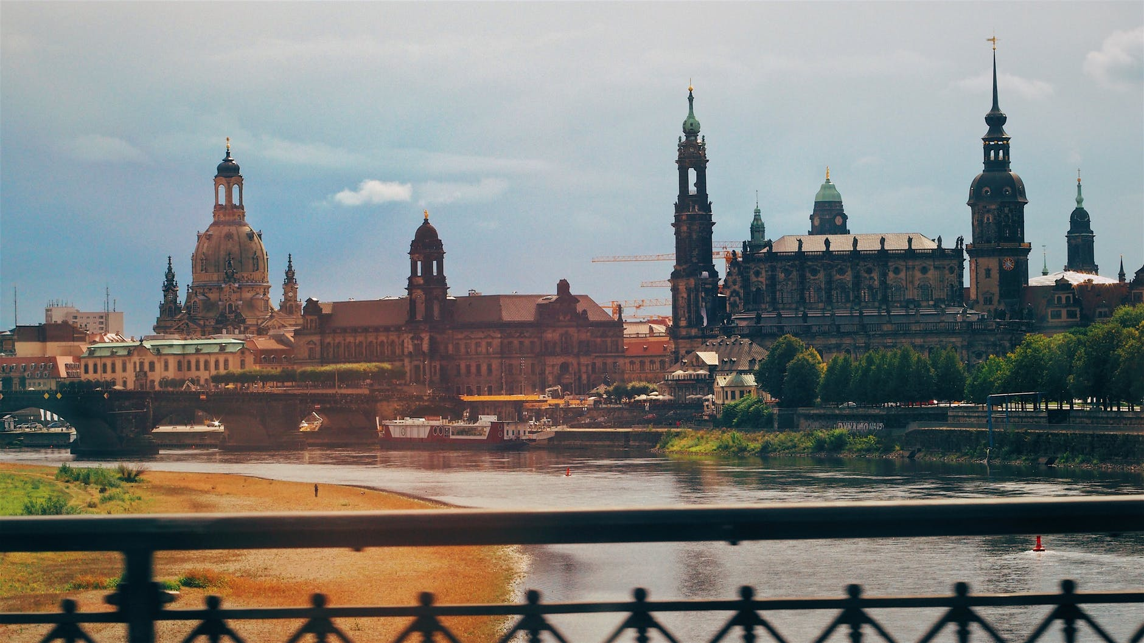
Tour highlights

Slide 11
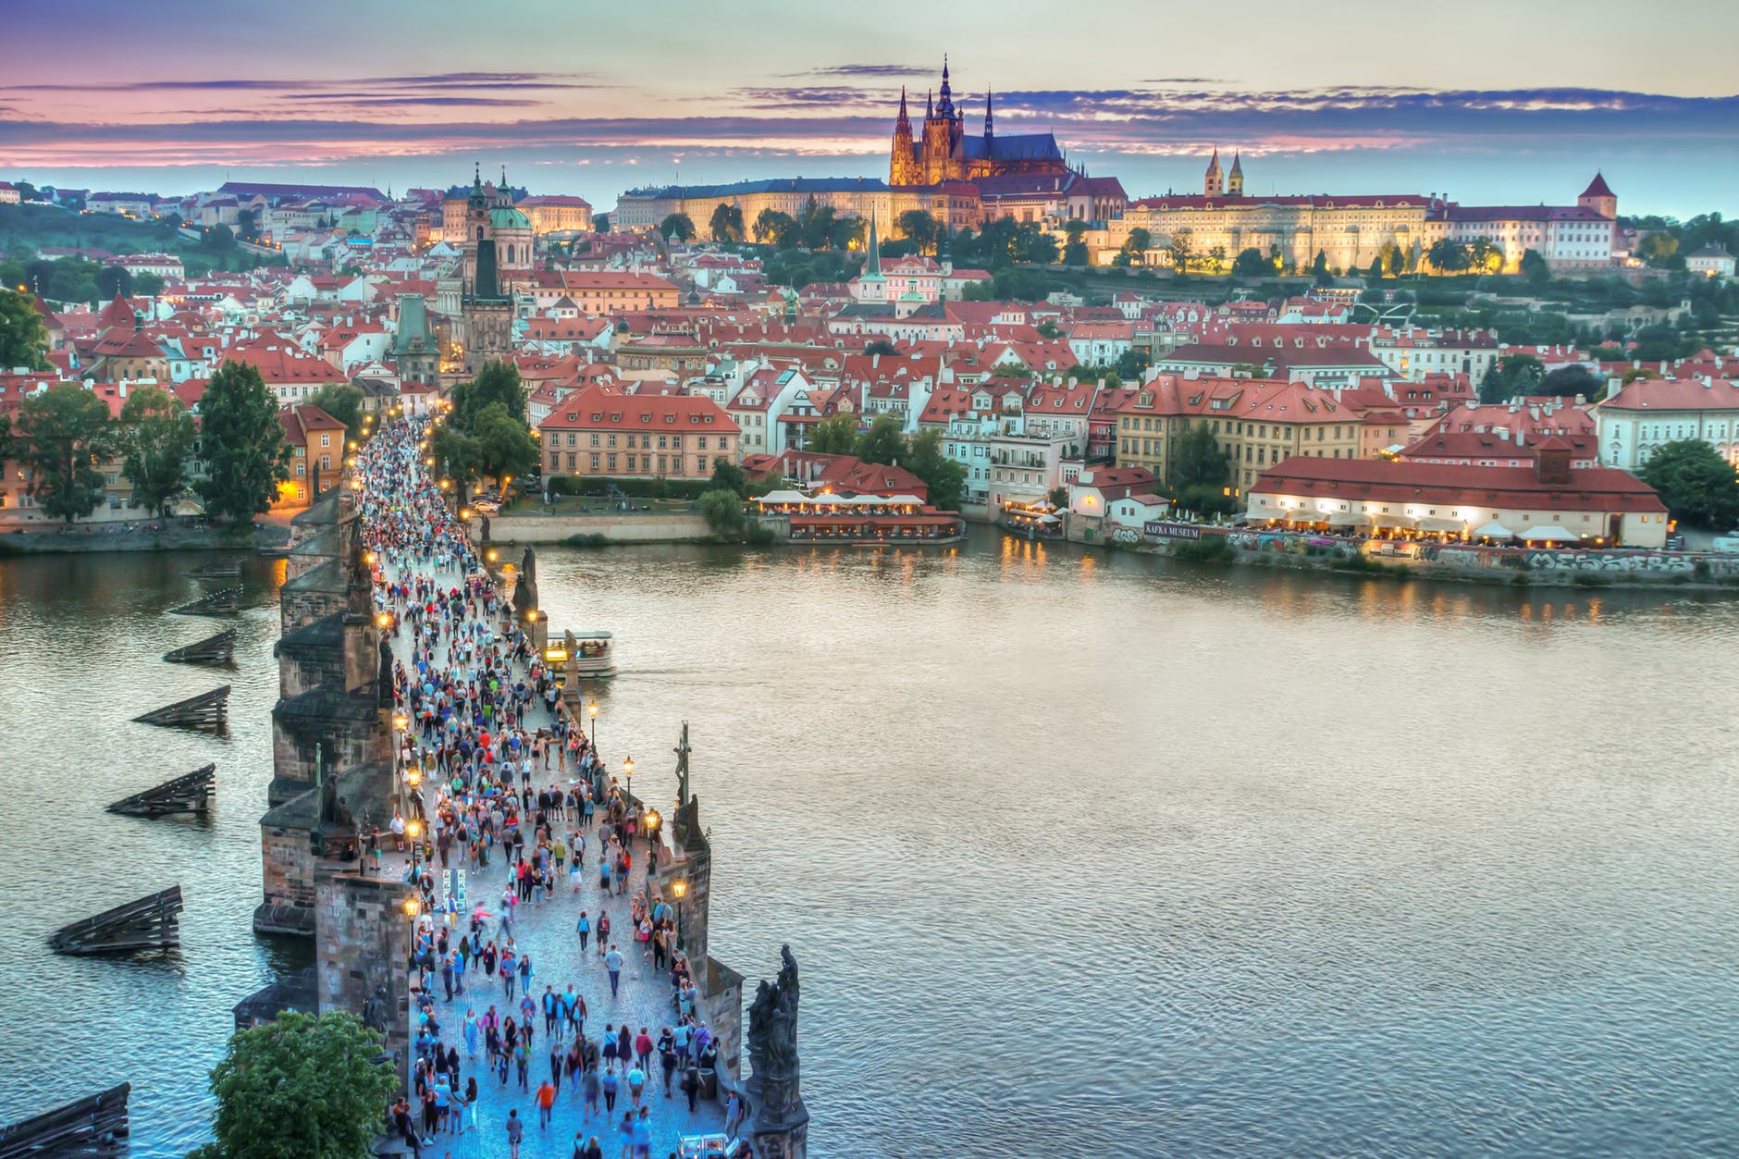
Tour highlights

Slide 12
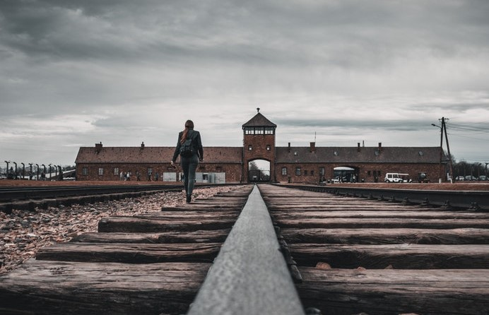
Tour highlights

Slide 13
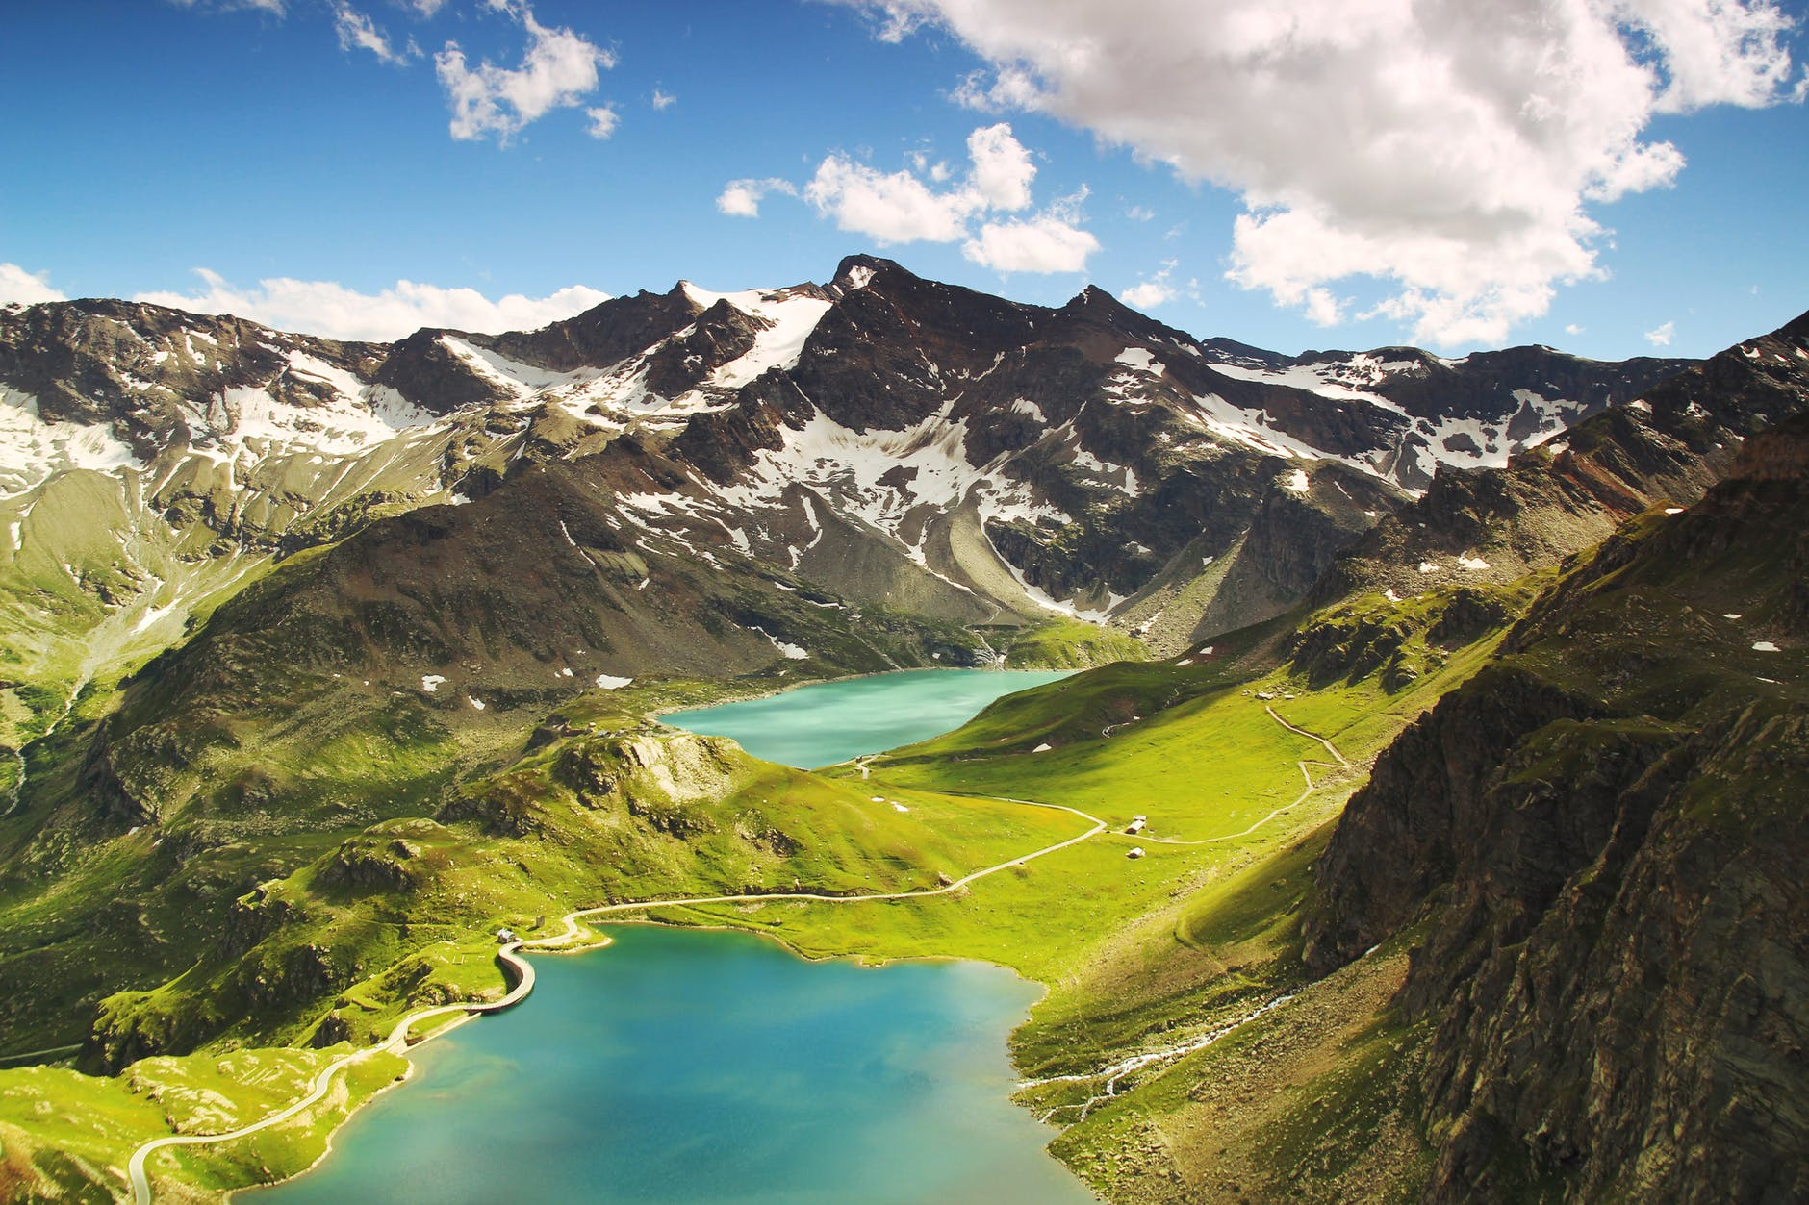
Tour highlights

Slide 14
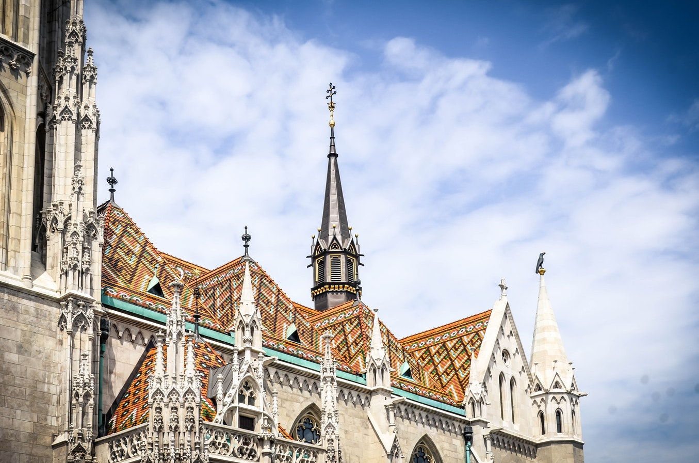
Tour highlights

Slide 15
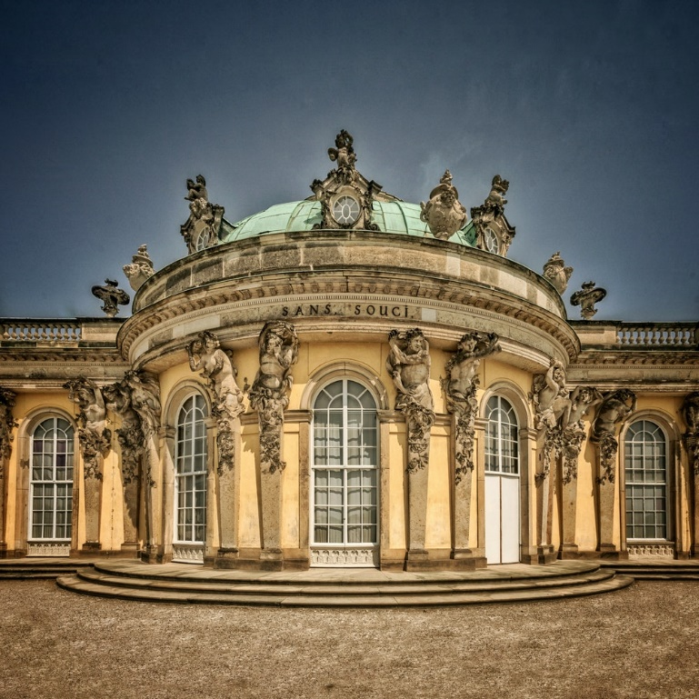
Optional Excursions
Postdam
Take a half-day excursion to Potsdam, where the postwar administration of Germany was decided at the 1945 Potsdam Conference. Potsdam was also the royal playground of Frederick the Great of Prussia; see baroque palaces, pavilions, and the royal residence’s gardens. Take a guided visit inside either Sanssouci or Cecilienhof.

Slide 16
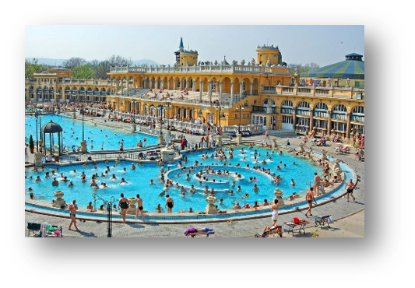
Optional Excursions
Budapest Baths
Take a guided excursion to Budapest’s Széchenyi Thermal Bath, the largest of its kind in Europe. Our prepaid ticket allows them to skip the lines and they will be able to try different types of baths at the location. This is a well-known practice in Hungarian culture!
This excursion is not included in the program price.

Slide 17
Our educational partner

Slide 18



Why EF?
The World Leader in Educational Travel
Over 50 years of experience
First and foremost, they’re an education company
Incredible travel experiences at the guaranteed lowest price
EF’s Traveller Support Team will help with any questions at any point in the process
EF is highly respected in the industry by the following organizations

Slide 19
weShare enhances every tour
Personalized learning powered by students’ curiosity
A free experience to make each student’s tour even more rewarding and fun
Puts a personal lens on the tour, based on individual interests and passions
Online: Connect your own interests to your destination and ask a question that personalizes your tour
On tour: Investigate your question through activities like visits to local sites and interviews with locals
Back home: Reflect on and share your findings through a creative final project

Slide 20
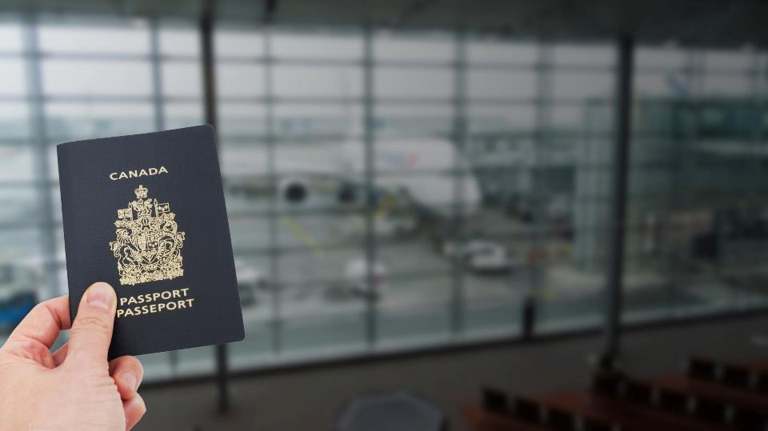
EF’s commitment
to our safety
With over 50 years of experience and a global presence, EF is there to help us whenever and wherever we need it.

Slide 21
Round-the-clock safety with EF
Over 50 years of experience
With their experience and a global presence, EF is there to help us whenever and wherever we need it
24/7 Bilingual Tour Director
Experienced, knowledgeable, and trained to handle every travel detail on tour
Peace of Mind Policy
We can feel secure planning our trip knowing our group has travel flexibility if our plans change due to unforeseen circumstances
Chaperones
Allows for more eyes on students
24-hour on-call service
Around the clock access to local EF offices as well as our worldwide and North American headquarters
Travel wristbands and backpacks
To help us stay together easily. Plus, wristbands have easy-to-access EF contact information for each country

Slide 22
What’s included & what’s not

Slide 23












What’s included in the Program Price
Round-trip airfare
On-tour transportation
Safe, quality hotel rooms
Full-time, bilingual Tour Director
Educational itinerary
Guided tours and activities
Breakfast and dinner daily
24-hour on-tour assistance
Traveller Support Team
Tour Donation page
weShare
Travel gear
Includes departure taxes and airport fees
Office de la protection du consommateur (OPC) Travel Agent Compensation Fund (FICAV) contribution of $1 per $1000 for residents of Québec.
Price includes HST/GST where applicable. No HST/GST applicable on international travel.
Notes:
INTERNATIONAL TOURS

Slide 24
What the Global Travel Protection Plan covers
Tour cancellation and interruption
Illness and accident
Baggage and property
24-hour access to an English-speaking representative
The Global Travel Protection Plan is underwritten by Chubb Insurance Company of Canada.
For complete terms, conditions and exclusions, please visit eftours.ca/coverage.
Notes:
The Global Travel Protection plan is $189 and is automatically applied to the final price quote for this tour. You may opt-out of this Plan by contacting EF Educational Tours within 30 days of enrolment. After 30 days, it is non-refundable.

Slide 25
What are you responsible for?
Spending money
For additional tour experiences, free time activities, souvenirs, beverages, lunches, and snacks ($30-$65 per day).
Tips
For our Tour Director, bus driver, and local guides (around $10 per day, in local currency).
Airport baggage fees
Passport and/or travel visa

Slide 26
Passports & visas
All travellers are responsible for securing necessary documentation.
Passports
Valid passports are required for all travellers. Passports may take up to 14 weeks to process.
Important note: Passports must be valid for at least six months after our return date.
Visas
Non-Canadian citizens may require special visas or other travel documents.

Slide 27
Reserving your spot

Slide 28
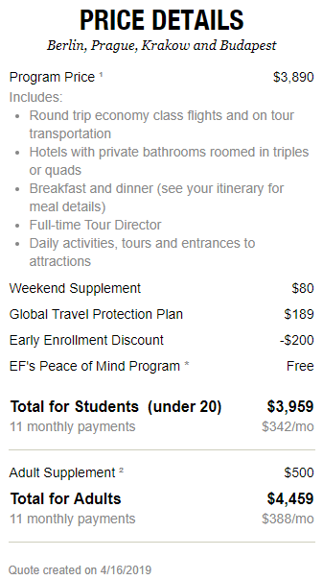
Paying for your tour
Educational travel at the guaranteed lowest price
Early enrollment
discount of $200
valid until 05/05/2019
Requested Departure Date: 04/10/2020
Requested Return Date: 04/19/2020
Requested Departure Gateway: Whitehorse (YT)
Full quote available online at eftours.ca
This quote is valid until 04/30/2019

Slide 29
Payment Options
Automatic Payment Plan
After you enroll with the $199 non refundable deposit, payments are automatically deducted from your bank account monthly or bi-weekly.
Final payment extended up to one month before your tour
Chequing or savings account accepted
Manual Payment Plan
Receive invoices and make payments in less frequent installments
Accounts must pay the $199 non refundable deposit upon enrollment; $500 due 30 days after enrollment; and additional $500 due 90 days after enrollment
Final payment deadline is 99 days before your tour (for tours departing before September 30, 2019) or 110 days before your tour (for tours departing on or after October 1, 2019)
For travellers enrolling between 175 and 99 days prior to departure: $699 due upon enrolment (includes $199 non-refundable deposit). Remaining balance is due 99 days prior to departure.
Payment methods accepted: direct debit, from your bank account, personal cheque or credit card (Visa or MasterCard)
Pay in full
Pay the entire balance at the time you enroll
Payment methods accepted: direct debit, from your bank account, personal cheque or credit card (Visa or MasterCard)
2
3
1
You can find EF’s Booking Conditions at eftours.ca/bc which outline the tour inclusions, payment schedule, cancellation and refund policies.

Slide 30
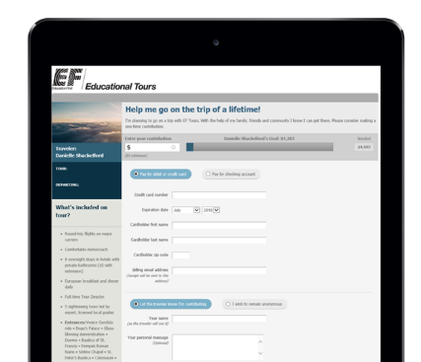
Your tour donation page
A quick and easy way to
raise money for your tour
___
How it works
  Located on your personal EF website
  Share your donation page on social media or via email with friends and family members you’d like to ask for support
  All donations are automatically added to your account

Slide 31
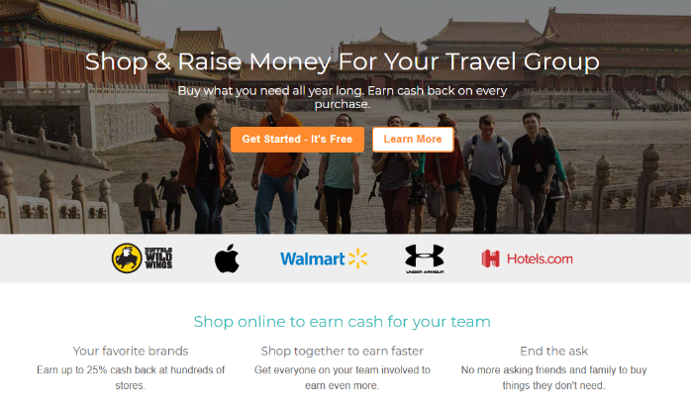
FlipGive
Shop online and raise money for your tour
___
How it works
  Create an account at eftours.flipgive.com
  Easily reach out to your network for support
  Earn up to 25% cash back on purchases
  Withdraw your funds and pay for your tour

Slide 32
Who’s in?
Enrollment window opens: Right Now!
To enroll you’ll need your tour number:
2248161JP
Two easy ways to enroll
Online: eftours.ca/2248161JP
Phone: 1-800-263-2806

Slide 33
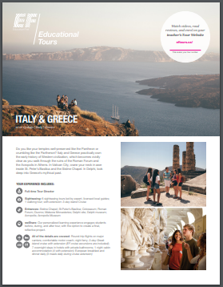
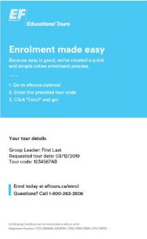
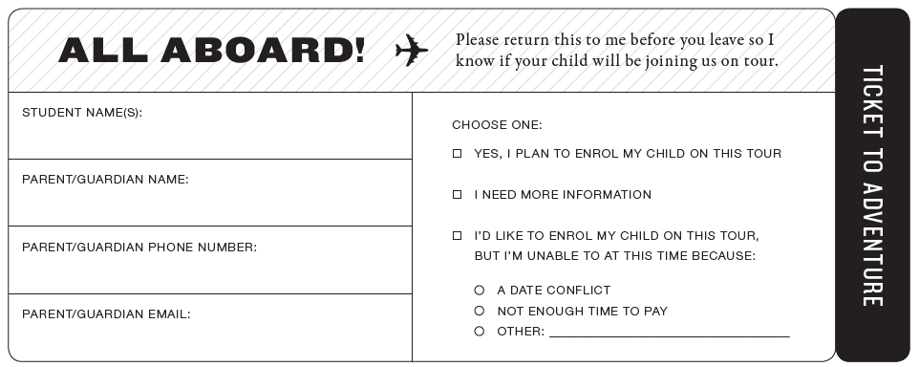
Take these home with you!
Hand your tickets
to your Group Leader
on your way out!
Questions?
Contact EF Educational Tours
Day by Day Itinerary
Provides tour inclusions and highlights
Enrolment Info Card
Has your personalized tour details
Explains in 3 steps how to enrol online.
Phone: 1-800-263-2806
Online: www.eftours.ca/help-centre
In person:
80 Bloor St. W.,
16th Floor
Toronto, ON
M5S 2V1
110 Cambie St.,
Suite 300
Vancouver, BC
V6B 2M8

